Slide 1


FAKE NEWS DETECTION USING HYBRID APPROACH IN NATURAL LANGUAGE PROCESSING
31/12/2024
AIT2109611 Siau Soon Hong
Supervisor: Dr. Zafar Raheel

Slide 2

Fake News Detection
Introduction
Rapid growth of social platforms has revolutionized news consumption
Fake News can be driven by profit, viewership, or political agendas, make it hard to ensure media integrity
The research is aimed to find a hybrid solution for fake news detection in NLP

Slide 3

Challenges of Fakes News Detection
01 | Societal Impact
02 | Insufficient of Methods
Problem Background
Fake News disrupts society, causing economic losses, losing trust in media
Existing methods such as basic machine learning and deep learning approaches is not sufficient

Slide 4



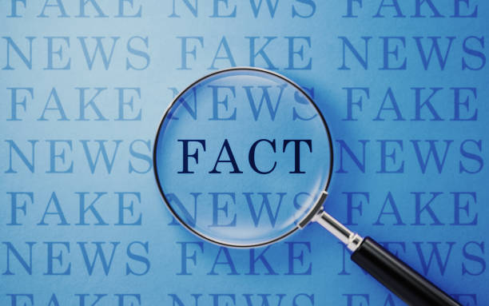
Aims and Objectives
To differentitate key features and patterns of real and fake news
To improve accuracy using advanced deep learning models for fake news detection

Slide 5

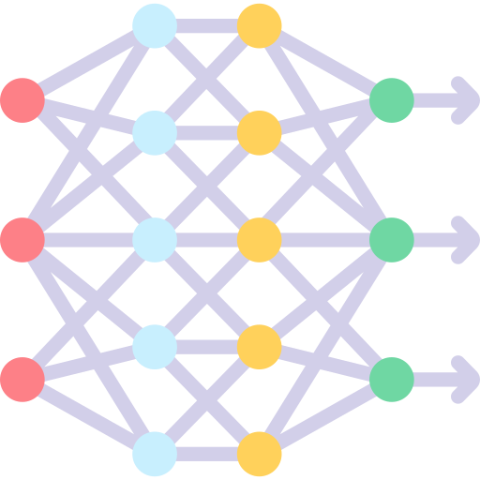



Overview of Machine Learning & Deep Learning Models
Literature Review
High-level of approaches (optimization challenges, hybrid models, text mining, etc.)
Deep Learning Architectures in NLP: CNN, TCN, and CapsuleNet
Text Embedding Techniques
Attention Mechanism in NLP
Bi-GRU vs. Bi-LSTM

Slide 6

Preprocessing Stage
Methodology
Dataset Labelling and Shuffling
Removing URLs and IPs
Removing Stop Words
Stemming
Tokenization

Slide 7

Dataset Used
Dataset | Total | Topic | # Of Articles | Class
ISOT | 44898 | government | 1570 | Fake
 |  | news | 9050 | Fake
 |  | Middle East | 778 | Fake
 |  | US news | 783 | Fake
 |  | left news | 4459 | Fake
 |  | politics | 6841 | Fake
 |  | news | 9050 | Fake
 |  | world news | 10145 | True
 |  | politics news | 11272 | True
Created by the ISOT lab at the University of Victoria
Contains 45,000 articles on politics and world events from 2016-2017
It includes titles, dates, topics, and texts from Reuters for true news and various outlets for fake news
Table 3.2: ISOT Dataset Distribution

Slide 8
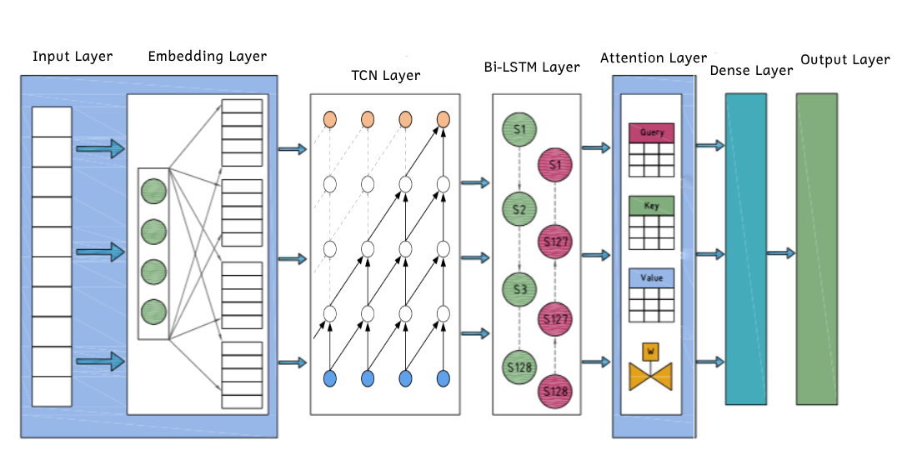
Model Structure
Figure 3.1: Proposed Model Structure

Slide 9

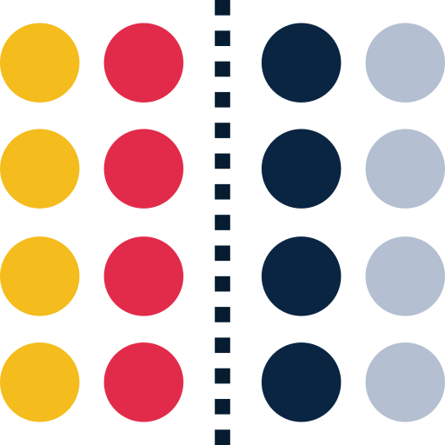

Embeddings allow algebraic operations to capture relationships
Glove Embedding
1
e.g., king - man + woman = queen
Embedding Space in GloVe: Similar Meanings, Close Vectors
2
e.g., king/queen, happy/sad.
4
5
Sentence Similarity Measurement
3
Sentence 1: The cat is on the mat.
Sentence 2: A cat lies on a mat.

Slide 10
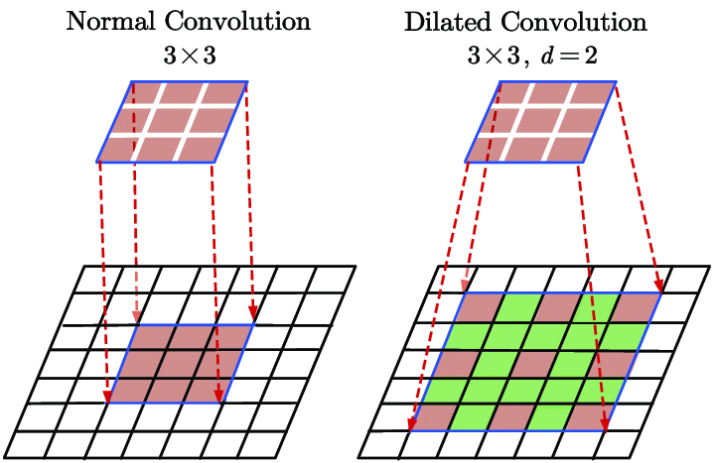
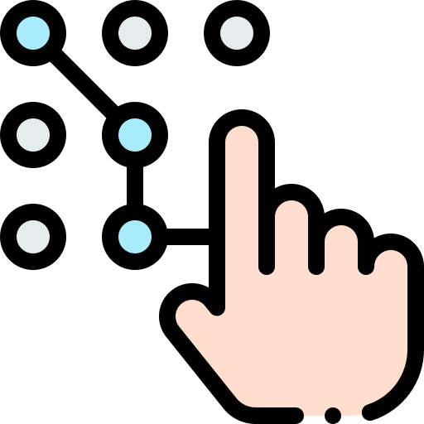
Processes word embeddings from sentences
Temporal Convolution Network Layer
Captures sequential patterns in text, such as dependencies between words
Dilated convolutions expand the receptive field
to analyze more context
without increasing kernel size

Slide 11

Processes the text in both directions (left-to-right and right-to-left) Enhances LSTM performance by analyzing both past and future contexts
Bi-LSTM
Example:
"The study suggests coffee causes cancer"
vs.
"Coffee causes cancer, suggests a flawed study"
BiLSTM distinguishes the difference based on order and surrounding context.

Slide 12
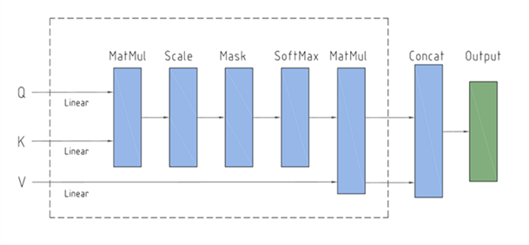
Self-Attention
Attention Layer
(Self Attention Process) Q = K = V
Highlight the context awareness and relevant features
Detect the hidden relations in news data
Attention score will be assigned to fake and true sequence

Slide 13
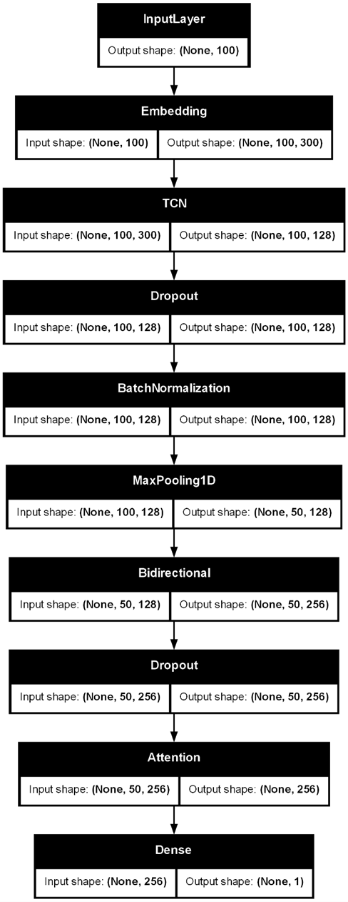
Detailed Model Structure
Figure 3.1.6: Workflow of Model (TensorFlow Plot)

Slide 14
Comparison of Evaluation Metrics
Results & Analysis
Model | Accuracy | Precision | Recall | F1 score
CNN+LSTM | 0.943 | 0.964 | 0.910 | 0.936
CNN+BiLSTM+ATT | 0.974 | 0.977 | 0.967 | 0.972
TCN+BiLSTM+ATT | 0.976 | 0.969 | 0.979 | 0.974
Figure 3.1.6: Workflow of Model (TensorFlow Plot)

Slide 15
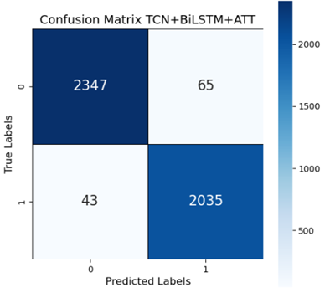
Analysis of Confusion Matrix
Table 4.5: Interpretation of Confusion Matrix
Model |  | Predicted:True News | Predicted:Fake News
CNN+LSTM | Actual: True News | 2342 | 70
 | Actusl: Fake News | 187 | 1891
CNN+BiLSTM + ATT | Actual: True News | 2365 | 47
 | Actual: Fake News | 68 | 2010
TCN+BiLSTM + ATT | Actual: True News | 2347 | 65
 | Actual: Fake News | 43 | 2035
Figure 4.5: Confusion Matrix of Models

Slide 16

Implementation in GUI

Slide 17
Future Work Field
Conclusion
Summary
The proposed model outperformed most of the state-of-art hybrid model by accuracy of 97.6
TCN is better than CNN in NLP Application
Cost Reduction
Mixed Dataset
Decreasing processing costs
Using more distilled layering
Establishing a median prediction value of partially real or partially fake

Slide 18
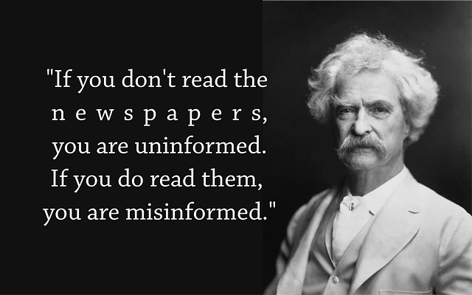
THANK YOU!
Any questions?

